Slide 1
AIR FARE PREDICTION:
GROUP MEMBERS:
1) Tushar Singh
2) Neha Khandekar
3) Nabanita Paul
4) Sai Rahul Thota
5) Rajat

Slide 2
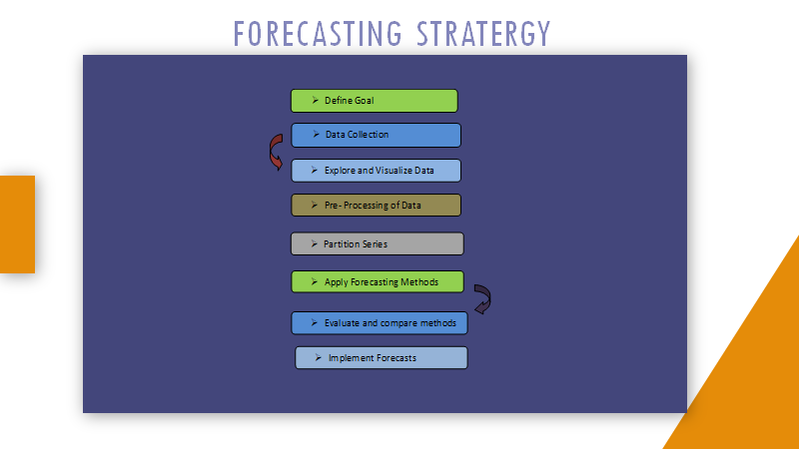

Slide 3
Buisness Objective:
To predict airfare, as travel is popular these days, with different air ticket booking channels, travellers are trying to make sense and understand how airlines price their tickets over time.
We want to explore previous airfare data and build a model to predict the price fluctuations over time so that the consumer could benefit from it.
We want to identify dependency over many endogenous variables.
Should get the least possible RMSE and the model should be deployed using Flask/ RShiny.

Slide 4
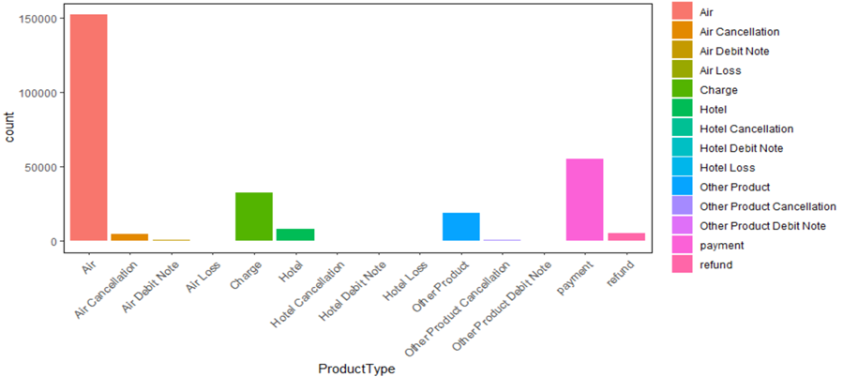
Data distribution based on count of Product Type

Slide 5
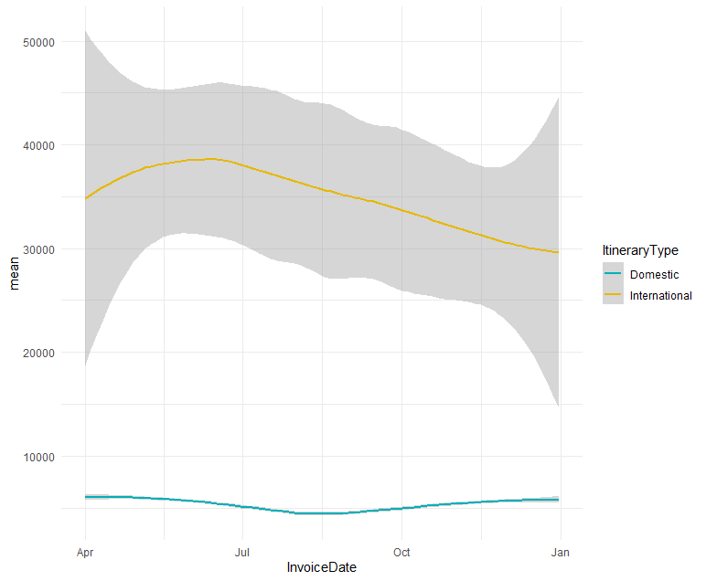
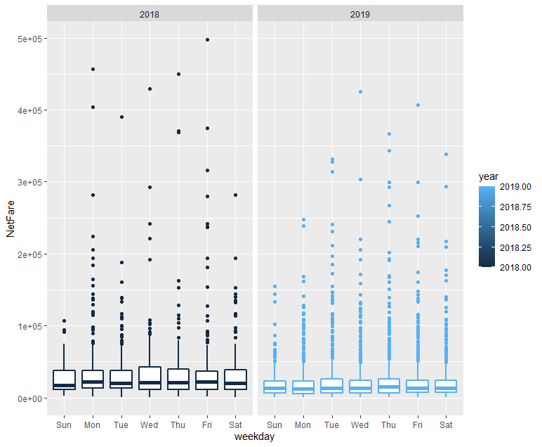
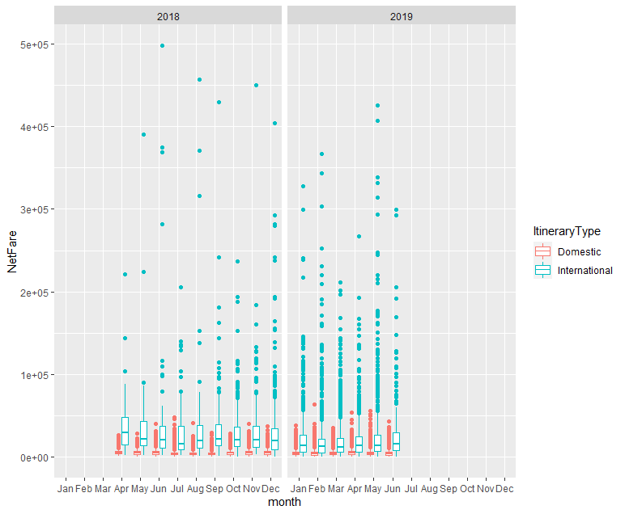
Exploratory Data Analysis:

Slide 6
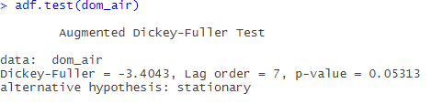
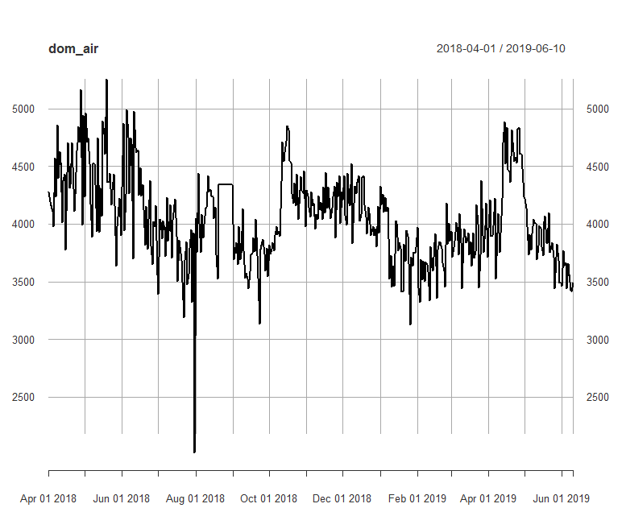
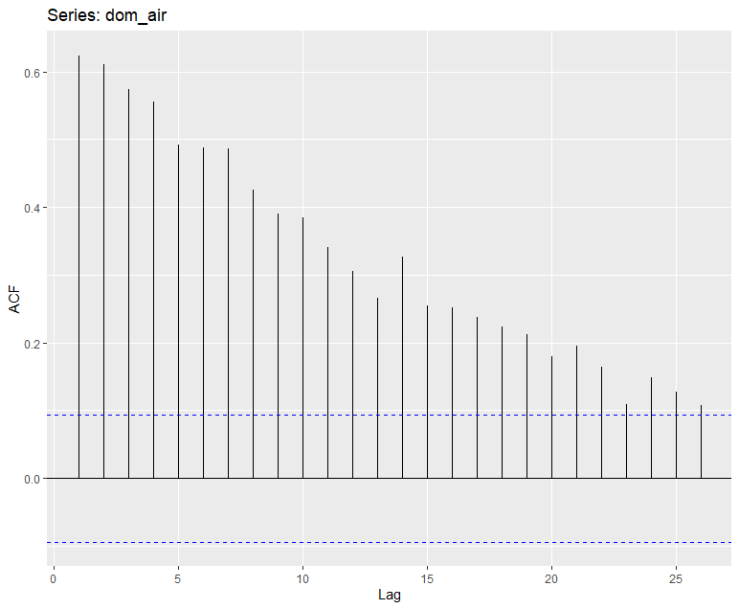
Model Building:
- We have taken the average for each day and computed the data.
-so the dataset will consist of 436 rows and 2 columns

Slide 7
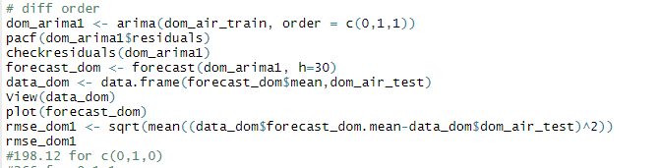
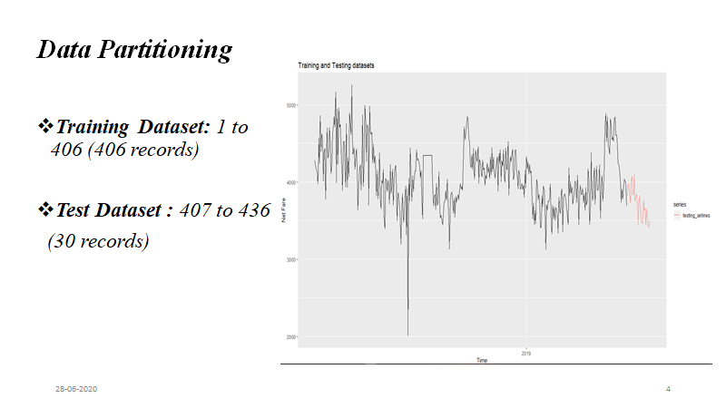
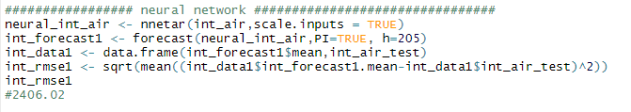
Best model for Domestic Fare:
Division of dataset for training and testing:
Best Model for International Fare:

Slide 8
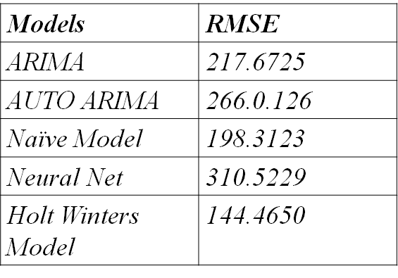
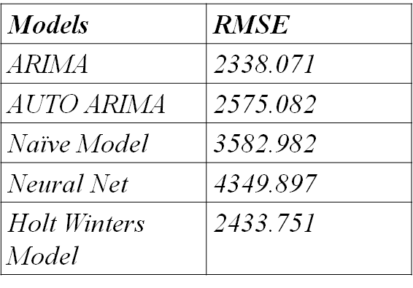
Model Evaluation:
Domestic Models:
International Fare:

Slide 9
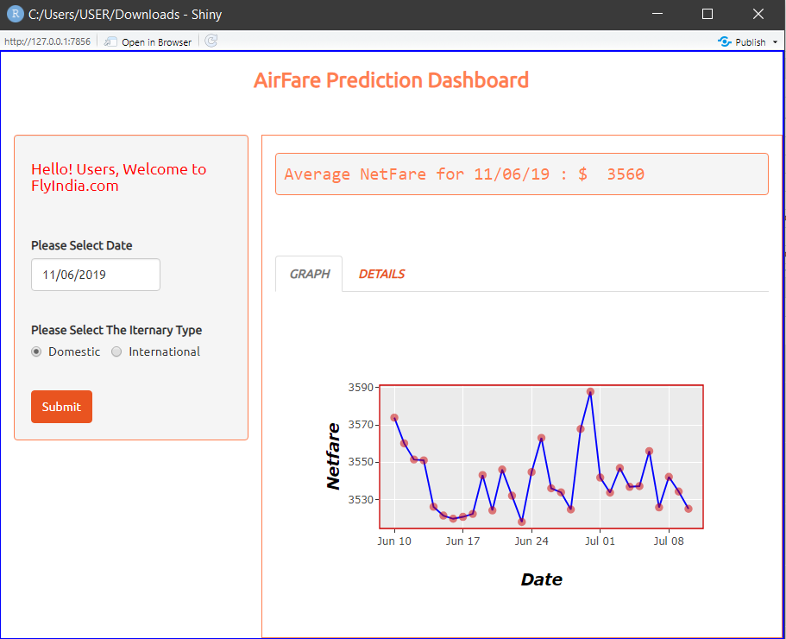
Deployment:

Slide 10
THANKYOU ALL

